Slide 1
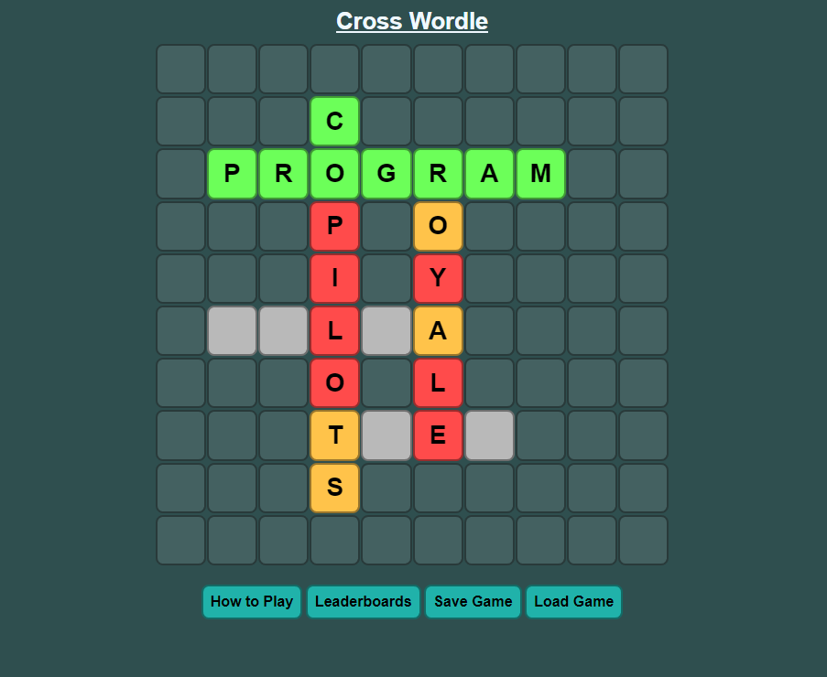
Cross Wordle
A word game by Matteo Salverio

Slide 2
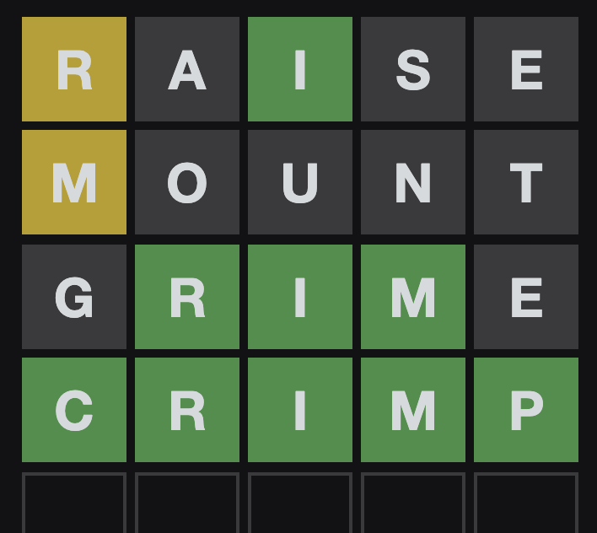
The Prompt
In 2022, Wordle and similar word games were all the rage across the world. Develop a word game with rules and a theme of your choice.
The game should be an executable game, either through the Internet or through a local installation (review guidelines about Internet access at the National Leadership Conference).
The game should contain a scoreboard.
The game should contain a leaderboard and celebratory messages.
The game should have a minimum of three levels.
The game should have an instructional display.

Slide 3
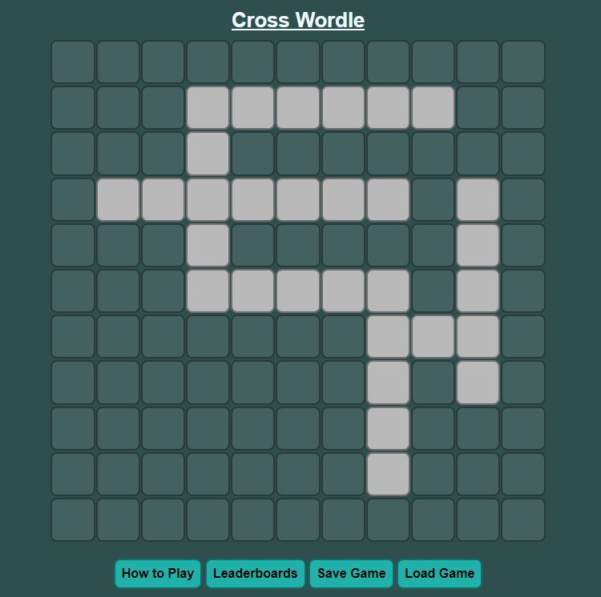
My Game
The game that I created is called Cross Wordle.
It is like Wordle but takes the gameplay to the second dimension with a full crossword-style puzzle connecting words and ideas, each being a puzzle of their own.

Slide 4

Programming Language
I chose to make this game using JavaScript on an HTML page.
It can utilize HTML design features
Seamless communication between front and back-end

Slide 5
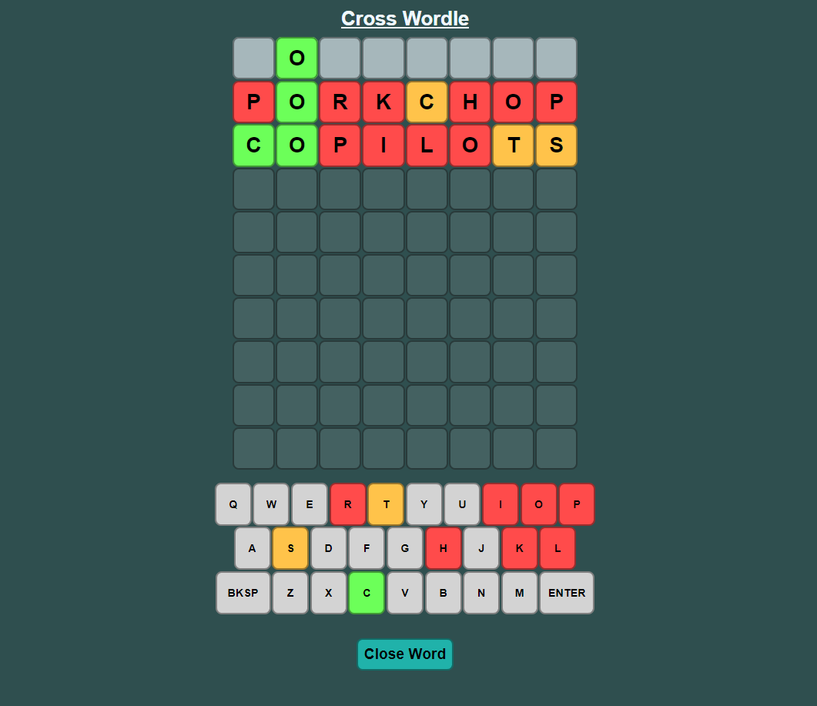
Gameplay Summary
The game is played mostly like a crossword puzzle.
Takes the simplicity of Wordle but adds some extra challenge to it.

Slide 6
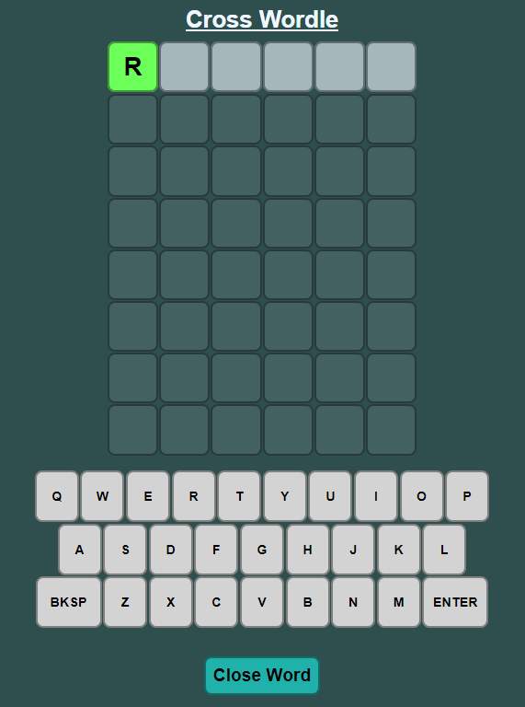
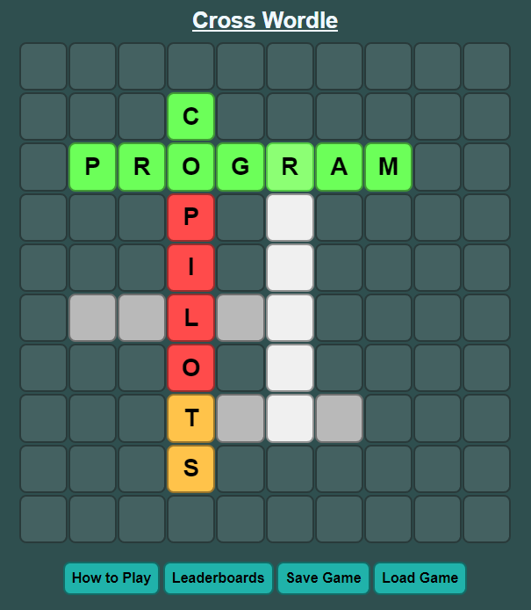
Selecting a Word
Hover and click on desired word
Wordle-like panel for each word

Slide 7
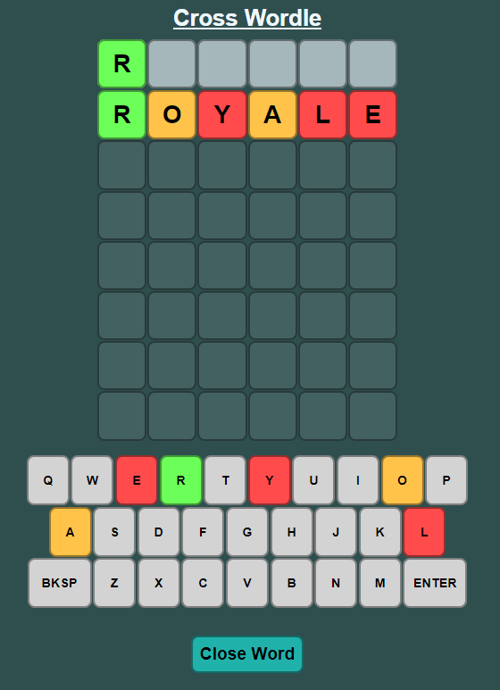
Making a Guess
The player may type using their physical keyboard, or the on-screen keyboard to enter letters.
Guess will be spellchecked and submitted as a guess.
Green letters are correct, orange letters are in the incorrect place, and red letters are incorrect.
The player doesn’t have to remember what they’ve already found.

Slide 8
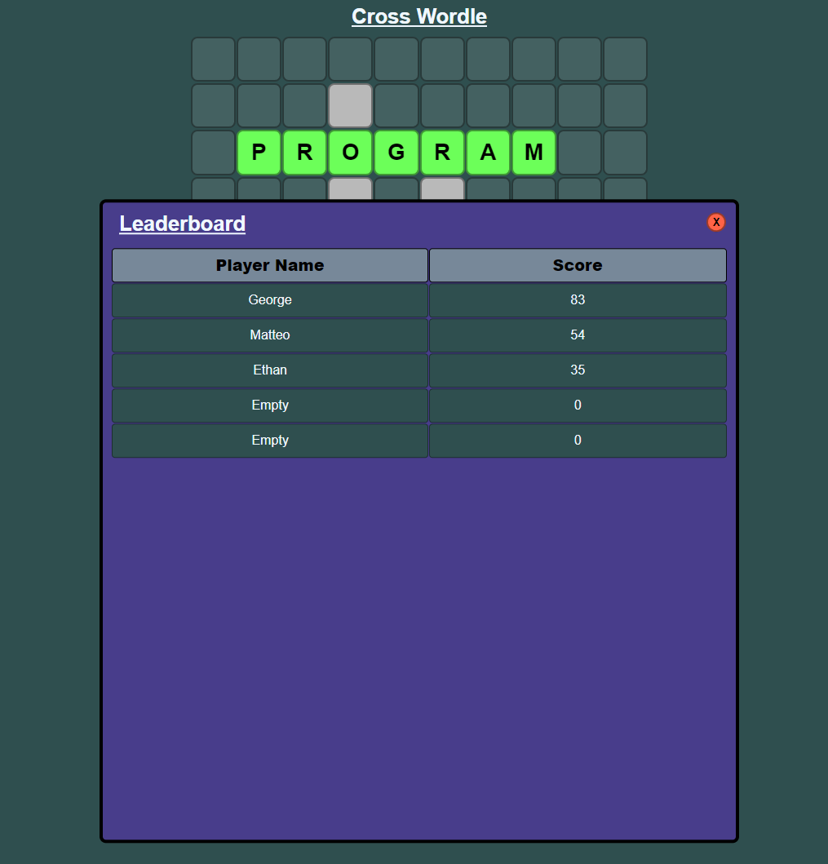
Finishing the Game
Score is calculated as follows:
Green Letters: 5 points
Orange Letters: 1 point
Red Letters: 0 points
If the player is within the top five players based on their score earned, they will be displayed on the leaderboard.

Slide 9
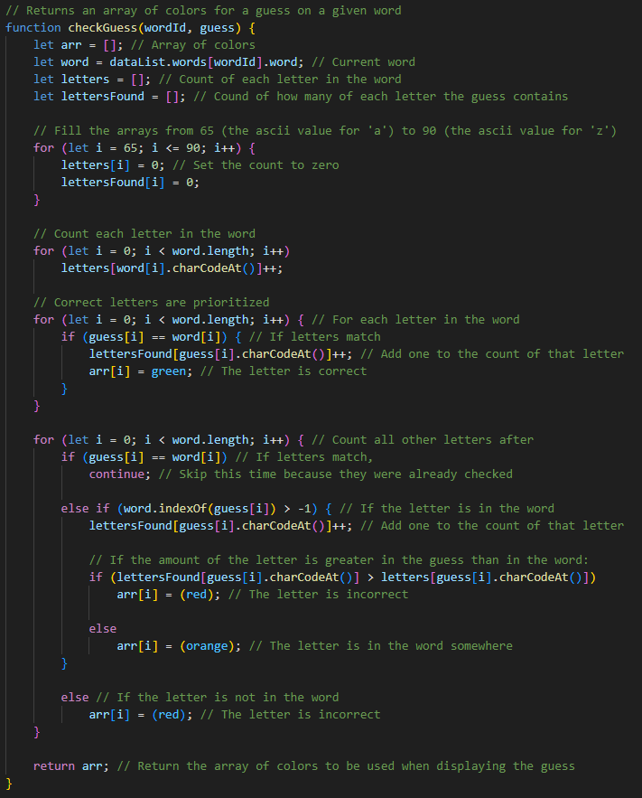
Code Snippet

Slide 10
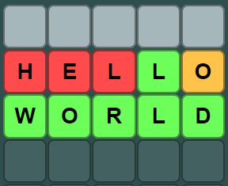
Example

Slide 11
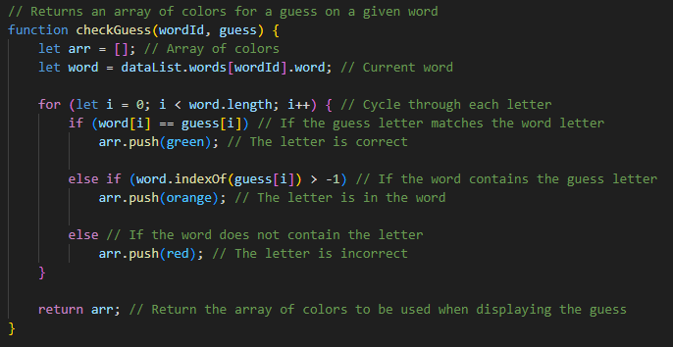
If-Else Tree Example

Slide 12
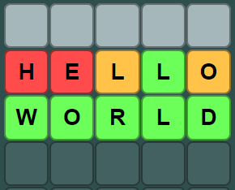
Example 2

Slide 13
Art style
I went through many design variations for this game, but ended up going with a simplistic, yet colorful design.
Bland background color makes the letter spaces really stand out.
Simple design allows for better focus

Slide 14
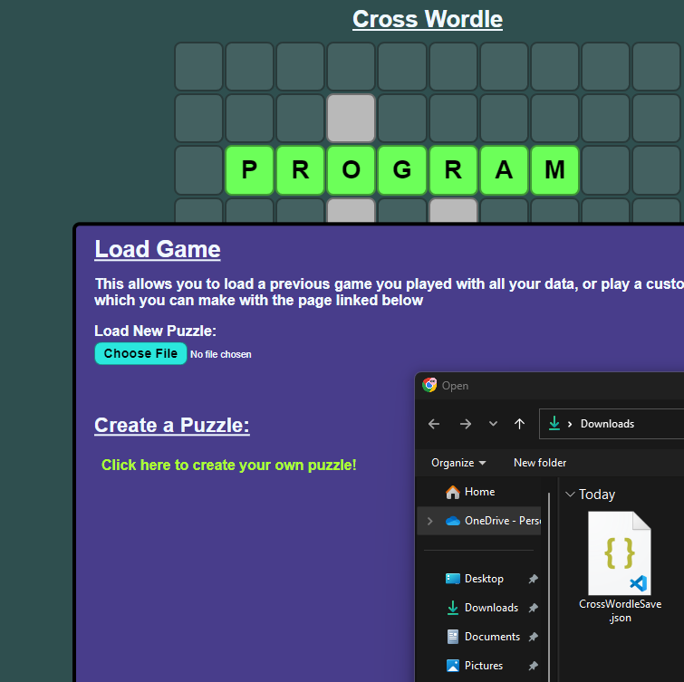
Saving/Loading Game
You can also save your game state as a file, so that you can leave and return to play later.
This feature also allows you to load custom puzzles, which can be created using the feature I will show next.

Slide 15
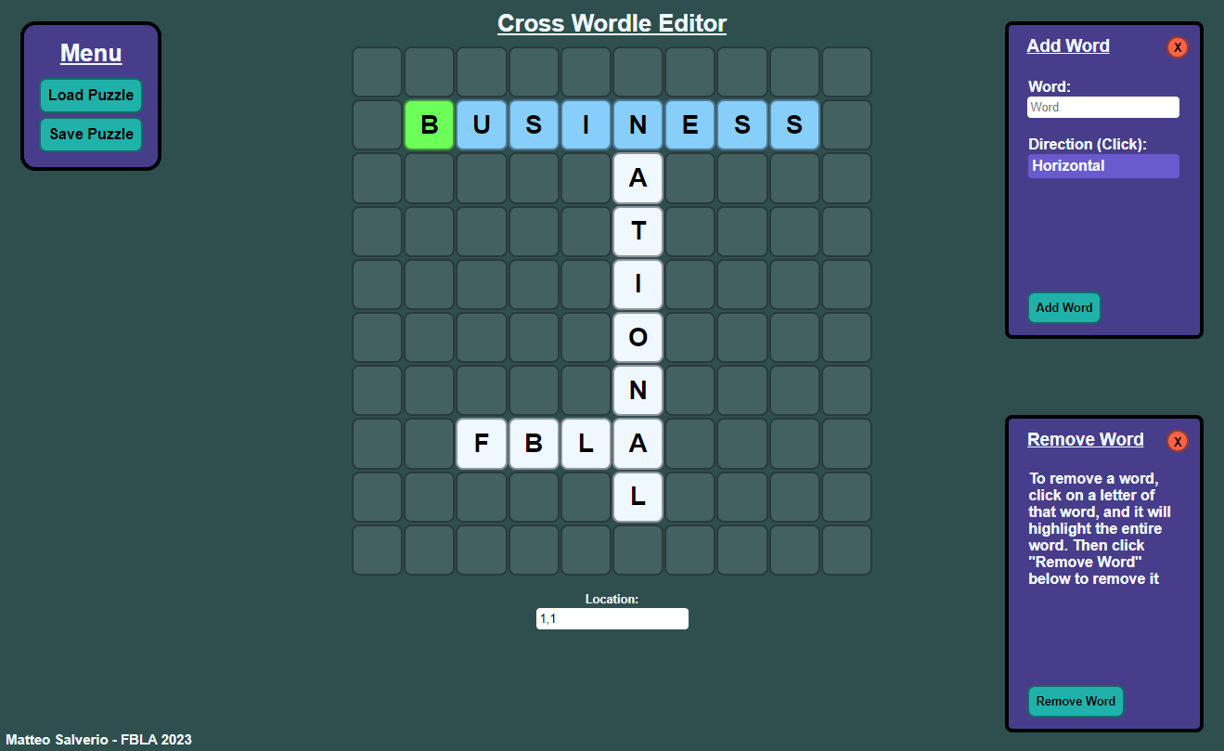
Creating Custom Puzzles
Using a tool that I created alongside the game; you can create your own puzzles for others to try out.
You can also edit existing puzzles, to make your ideal puzzle.

Slide 16
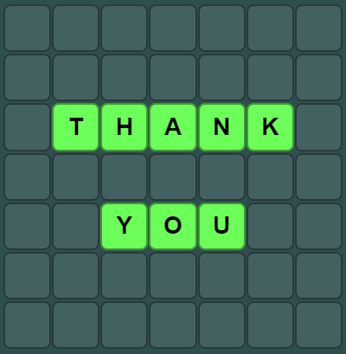
Thank You

